Slide 1
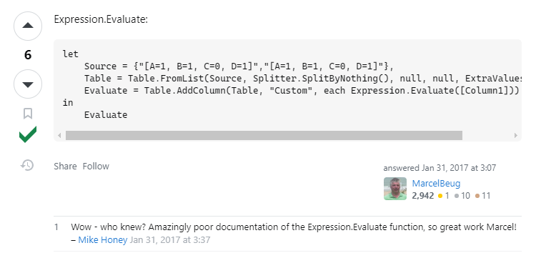
https://stackoverflow.com/questions/41947687/power-query-m-create-record-from-a-text-type-column
let
Source = {"[A=1, B=1, C=0, D=1]","[A=1, B=1, C=0, D=1]"},
Table = Table.FromList(Source, Splitter.SplitByNothing(), null, null, ExtraValues.Error),
Evaluate = Table.AddColumn(Table, "Custom", each Expression.Evaluate([Column1]))
in
Evaluate

